Slide 1
Chem 321 – Lecture 24
10/23/25 – Chymotrypsin

Slide 2
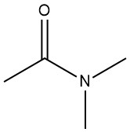
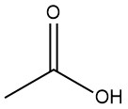

Proteases: hydrolysis of peptide bond
H₂SO₄, H₂O
+
Reflux
Notes:
Revisit mechanism, briefly, on board

Slide 3
Proteases: hydrolysis of peptide bond
Nucleophile
H₂SO₄, H₂O
+
Reflux
Activate amide, stabilize transition state
Chymotrypsin
+
(Next to a large aromatic amino acid)
Notes:
Revisit mechanism, briefly, on board

Slide 4
Proteases: hydrolysis of peptide bond
Notebook question
Chymotrypsin
+
(Next to large aromatic amino acid)
What residue could we use as a nucleophile?
Notes:
Potential nucleophiles

Slide 5
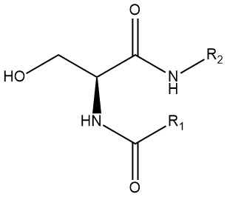
Chymotrypsin – active site
Are (protonated) alcohols particularly good nucleophiles?
No!
Serine: our nucleophile

Slide 6
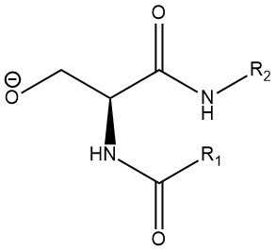
Chymotrypsin – active site
Notebook question
What residues could we use to deprotonate serine?

Slide 7
Chymotrypsin – active site
Notebook question
Base: histidine
Is histidine a particularly good base?
What is the pKa?
Notes:
Structure and pKa on board

Slide 8
Chymotrypsin – active site
Catalytic triad: produces the active nucleophile: negative serine. Involves: 1) serine 2) histidine to deprotonate the serine 3) aspartate to donate electrons to the histidine and make it a better base
From here on out, I’ll refer to just the serine nucleophile, but remember it’s really a complex network of hydrogen bonding and proton exchange
Notes:
On board

Slide 9
Chymotrypsin: reaction mechanism
“Ping pong” mechanism
Phase 1: attachment of substrate to enzyme (formation of tetrahedral intermediate)
Phase 2: release of product from enzyme (hydrolytic breakdown of tetrahedral intermediate)

Slide 10
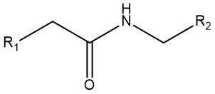
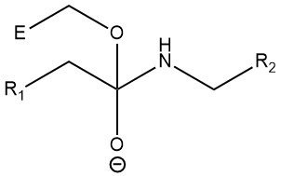


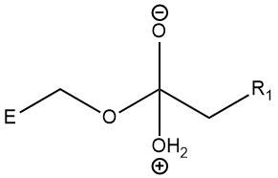
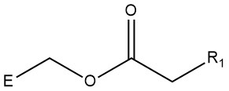
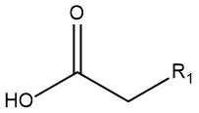
Tetrahedral intermediate #1
+
Substrate (R1 is a large aromatic amino acid)
Nucleophilic serine
Hydrophobic pocket
Hydrophobic pocket
Oxyanion hole
Product #1
Regenerated enzyme
Tetrahedral intermediate #2
+
Acyl-enzyme intermediate
Product #2

Slide 11
Features of the chymotrypsin catalytic mechanism
Notebook question
Before the break I told you about three ways that enzymes reduce ΔG^{ǂ}. Chymotrypsin uses all three of them.
What are the three ways that enzymes reduce ΔG^{ǂ} in general?
Describe how chymotrypsin uses each one, including specific residues of chymotrypsin in your answer.
Draw a reaction energy diagram of 1) an amide hydrolysis without catalysis and 2) an amide hydrolysis catalyzed by chymotrypsin. Your answer should include the energy and structure of 1) the reactant 2) the tetrahedral intermediate(s), and whatever components of the enzyme are interacting with them, and 3) the products

